Slide 1

Memory Layout
mirafra
TECHNOLOGIES
Narendran R
SWE - 1

Slide 2

Abstract Overview Diagram View Segments & Examples
mirafra
TECHNOLOGIES

Slide 3

Abstract
After compiling a C program, a binary executable file(.exe/a.out) is created, and after execution of program this binary file loads into RAM in an organized manner.
Memory layout in RAM has six components namely text segment, initialized data segment, uninitialized data segment, command-line arguments, stack, and heap.
Each of these six different segments stores different parts of code & and have their own read - write permissions.

Slide 4
Compilation Process…?
Source code
(.c file)
Preprocessor
(.i file)
Compiler
Assembly code
Assembler
(.s file)
Libraries
Object code
(.obj file)
Linker
Executable File
(.exe file)

Slide 5
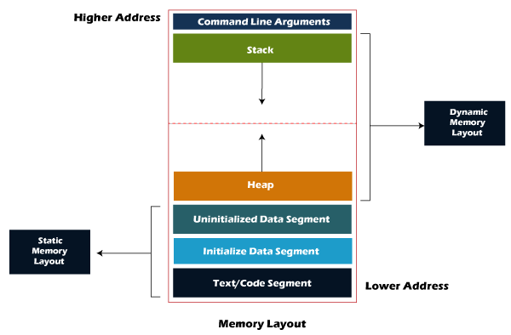
Diagramatic View Memory Layout

Slide 6
Text Segment
A text segment, also known as a code segment (or) text, which contains executable instructions/machine code.
Text segment has read-only permission to prevent the program from accidental modifications.
Text segment in RAM is shareable so that a single copy is required in the memory for frequent applications like text-editor, C compiler, shells, etc..,

Slide 7
Initialized Data Segment
Initialized data segment is part that contains external, global, static, and constant variables whose values are initialized at the time of variable declaration.
The values of variables can change during program execution, because this memory segment has read-write permission.
This Data segment can be further classified as:
1. Read-only area.
2. Read-write area.
( NOTE: Variable initialized as const variable comes under read-only area and, remaining all types of variable come in the read-write area )

Slide 8
Example of Initialized DS
#include<stdio.h>
//global variables stored in the read-write area of initialized data segment
char str[]= “Ravin";
int main(void) {
printf(“%s\n”,str);
str[0]=‘k’;
printf(“%s\n”,str);
return 0;
}
Output:
Ravin
kavin

Slide 9
Size of initialized Static variable
#include <stdio.h>
int main(void)
{
static int data =10; // Static variable of initialized data segment
return 0;
}
$ gcc memory-layout.c -o memory-layout
$ size memory-layout
text data bss dec hex filename
960 252 8 1216 4c0 memory-layout

Slide 10
Size of initialized Static & Global variable
#include <stdio.h>
int data1 = 0; //Global-variable of initialized data segment
int main(void)
{
static int data2 = 0; //Static-variable of initialized data segment
return 0;
}
$ gcc memory-layout.c -o memory-layout
$ size memory-layout
Text data bss dec hex filename
960 264 8 1216 4c0 memory-layout

Slide 11
Uninitialized Data Segment
An uninitialized data segment is also known as bss (b​lock s​tarted by s​ymbol) that contains all the static and global variables .
Here the values of variables stored in bss can be changed, so this data segment has its read-write permissions.
All variables in this segment initialized by the zero(0) and pointer with the null pointer
The program loader allocates memory for the BSS section when it loads the program.

Slide 12
Example of Un-Initialized DS
#include <stdio.h>
int global_variable; // Uninitialized global variable stored in bss segment
int main() {
static int static_variable; // Uninitialized static variable stored in bss
printf("global_variable = %d\n", global_variable);
printf("static_variable = %d\n", static_variable);
return 0;
}
Ouput:
global_variable = 0
static_variable = 0

Slide 13
Size of Un-initialized Static Variable
#include <stdio.h>
int main(void)
{
static int data; // Stored in uninitialized area
return 0;
}
$ gcc memory-layout.c -o memory-layout
$ size memory-layout
text data bss dec hex filename
960 248 12 1216 4c0 memory-layout

Slide 14
Size of Un-initialized Static & Global variable
#include <stdio.h>
int data1; //Un-initialized Global Variable
int main(void)
{
static int data2; //Un-initialized Static Variable
return 0;
}
$ gcc memory-layout.c -o memory-layout
$ size memory-layout
text data bss dec hex filename
960 248 16 1216 4c0 memory-layout

Slide 15
Heap Segment
Heap segment is used to allocate the memory during the run time (dynamic memory allocation)
Commands like malloc, calloc, free, realloc, etc are used to manage allocations in heap segment which internally use sbrk and brk system calls.
Heap generally begins at end of bss segment and, they grow and shrink in the opposite direction of Stack.
The heap area is shared by all shared libraries and dynamically loaded modules in a process.

Slide 16
Memory allocation in Heap
#include <stdio.h> int main() {
// memory allocating in heap segment char *p=(char*)malloc(sizeof(char)); return 0; }
(Note: It shrinks and grows in opposite direction of stack)

Slide 17
Stack segment
The stack segment follows the LIFO (Last In First Out) structure and grows downward to lower address, depends upon computer architecture.
Stack segment stores the value of local variables and values of parameters passed to a function information like the return address of its instruction
Each time function calls itself recursively, a new stack frame is created which allows set of variables of one stack frame to not interfere with other variables of a different instance of the function.
Stack segment grows in opposite direction to the heap.

Slide 18
To Understand stack segment
#include<stdio.h>
void foo() {
// local variables stored in stack when the function call is made
int a, b;
}
int main() {
// local variables stored in stack
int local = 5;
char name[26];
foo();
return 0;
}

Slide 19
Command-line Arguments
When a program executes with arguments passed from the console like argv and argc and other environment variables.
argc -> stores the number of arguments passed.
argv -> stores the value of actual parameters.
The value of these variables gets stored in this command line of this memory layout section.

Slide 20
Example of command line argument
#include<stdio.h>
int main(int argc, char *argv[])
{
int i;
// first value in argv stores file name
printf("File name = %s\n", argv[0]);
printf("Number of arguments passed = %d\n", argc-1);
for(i = 1; i < argc; i++) {
printf("Value of Argument_%d = %s\n", i, argv[i]);
}
return 0;
}

Slide 21
Output :
~$ gcc file_1.c -o file_1
~$ ./file_1 100 23 43 69
File name = ./file_1
Number of arguments passed = 4
Value of Argument_1 = 100
Value of Argument_2 = 23
Value of Argument_3 = 43
Value of Argument_4 = 69

Slide 22
Thank you..!

